Slide 1

Network Security Testing
CS 155 Elie Bursztein

Slide 2

Why testing security
Get a snapshot of the current security
Evaluate the capacity to face intrusion
Test backup plan

Slide 3
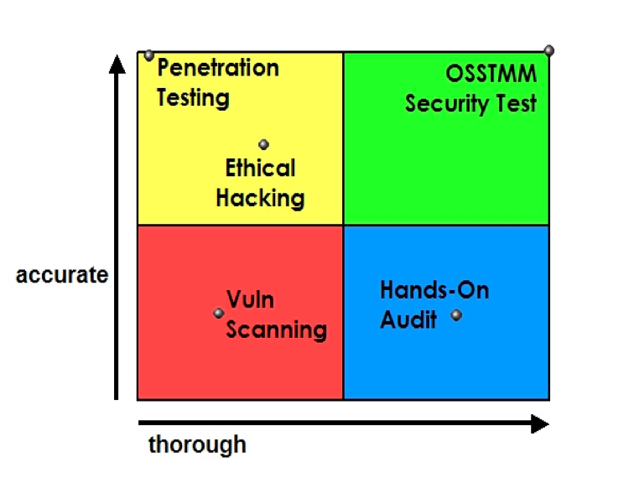
SCOPE
OSSTMM

Slide 4
Results
Date /type
Duration
Auditor and analyst associated
Test type
Scope
Test index
Channel test
Test vector
Verified test and metrics calculations of the operational protection levels, loss controls, and security limitations
Knowledge of which tests have been completed, not completed, or only partially completed, and to what extent
Any issues regarding the test and the validity of the results
Test error margins
Any processes which influence the security limitations
Any unknowns or anomalies

Slide 5
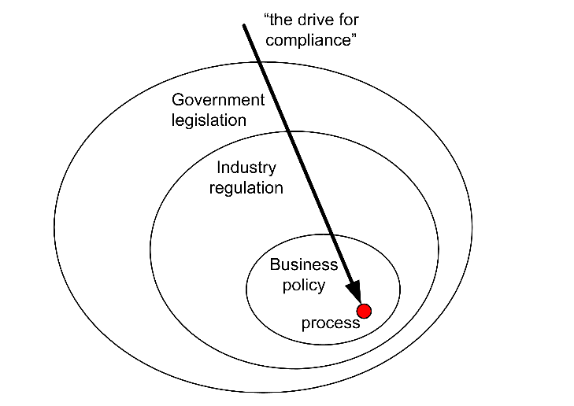
SCOPE
OSSTMM
Notes:
Legislation : compliance or jail
Industry : compilance or fine / dismissal from a group -> PCI
Policy : business organization level
Children’s Online Privacy Protection Act (COPPA).
• Anticybersquatting Protection Act (ACPA).
• Federal Information Security Management Act.
• U.S. Sarbanes-Oxley Act (SOX).
• California Individual Privacy Senate Bill – SB1386.
• USA Government Information Security Reform Act of 2000 section 3534(a)(1)(A).
• MITRE Common Vulnerabilities and Exposures - the RAV Security Limitations described within this
manual comply to the CVE descriptions for more efficient categorizations (http://cve.mitre.org/
about/terminology.html).
• DoD FM 31-21, Guerrilla Warfare and Special Forces Operations.
• Health Insurance Portability and Accountability Act of 1996 (HIPAA).
• OCR HIPAA Privacy TA 164.502E.001, Business Associates [45 CFR §§ 160.103, 164.502(e),
164.514(e)].
• OCR HIPAA Privacy TA 164.514E.001, Health-Related Communications and Marketing [45 CFR §§
164.501, 164.514(e)].
• OCR HIPAA Privacy TA 164.502B.001, Minimum Necessary [45 CFR §§ 164.502(b), 164.514(d)].
• OCR HIPAA Privacy TA 164.501.002, Payment [45 CFR 164.501].
• HIPAA Standards for Privacy of Individually Identifiable Health Information (45 CFR parts 160 and
164).
• FDA: Computerized Systems used in Clinical Trails. Electronic Records; Electronic Signatures; [21
CFR Part 11].

Slide 6
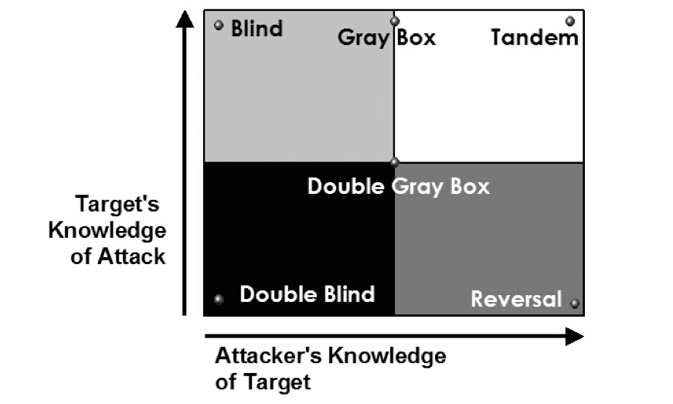
Security Test Type
OSSTMM
Notes:
Blind : attacker no / defender detailed knowledge
Double blind : no / no
Gray: limited / detailed
Double Gray : limited / limited
Tandem/white: detailed / detailed
Reversal : detailed / limited

Slide 7
Channel
Physsec
  Human
  Physical
SPECSEC
  Wireless communication
COMSEC
  Data networks
  Telecommunication
OSSTMM

Slide 8
Hacker Skill Level
T 1
Tier 2
Tier 3
Notes:
Tier1 : find new vuln / new attack
Tier2 : Highly skill/ hugh background
Tier3 : rely on public tool / exploit low knowledge

Slide 9

Network techniques toolbox
Network scouting
Os fingerprinting
Vulnerability scanner
Network trace analysis

Slide 10
Network scouting

Slide 11

Scouting toolbox
Unix standard tools
Nmap (“Network Mapper”)
  Free and open source
  Leading network scanner

Slide 12
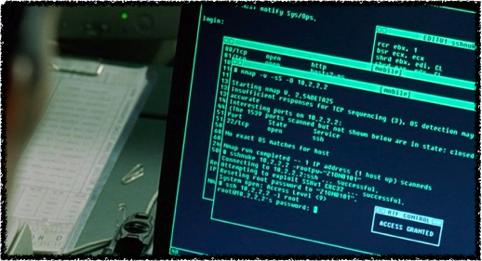
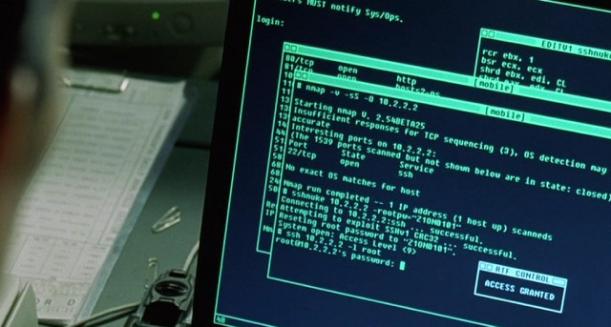
Why scouting is important ?
Scouting is the first step
You can’t attack what you don’t know

Slide 13
Scouting Process overview
Hosts
Ports
Services
Vulnerabilities

Slide 14
Topological Mapping
DNS info
Ping
Traceroute
Firewalking

Slide 15

Whois
Domain Name: STANFORD.EDU
Registrant:
Stanford University
The Board of Trustees of the Leland Stanford Junior University
241 Panama Street, Pine Hall, Room 115
Stanford, CA 94305-4122
UNITED STATES

Slide 16
Whois
Administrative Contact:
Domain Admin
Stanford University
241 Panama Street Pine Hall, Room 115
Stanford, CA 94305-4122
UNITED STATES
(650) 723-4328
sunet-admin@stanford.edu

Slide 17
Whois
Name Servers:
ARGUS.STANFORD.EDU 171.64.7.115
AVALLONE.STANFORD.EDU 171.64.7.88
ATALANTE.STANFORD.EDU 171.64.7.61
AERATHEA.STANFORD.EDU 152.3.104.250

Slide 18
Digging DNS record
Dig stanford.edu
;; ANSWER SECTION:
stanford.edu. 3600 IN A 171.67.216.3
stanford.edu. 3600 IN A 171.67.216.4
stanford.edu. 3600 IN A 171.67.216.7
stanford.edu. 3600 IN A 171.67.216.8
stanford.edu. 3600 IN A 171.67.216.9
;; AUTHORITY SECTION:
stanford.edu. 172800 IN NS Avallone.stanford.edu.
stanford.edu. 172800 IN NS Argus.stanford.edu.
stanford.edu. 172800 IN NS Atalante.stanford.edu.
stanford.edu. 172800 IN NS Aerathea.stanford.edu.
;; ADDITIONAL SECTION:
Argus.stanford.edu. 3600 IN A 171.64.7.115
Avallone.stanford.edu. 3600 IN A 171.64.7.88
Atalante.stanford.edu. 3600 IN A 171.64.7.61
Aerathea.stanford.edu. 3600 IN A 152.3.104.250

Slide 19
Zone transfer
Allow to dump the entire zone
Nowadays usually correctly protected
dig @server domain axfr

Slide 20
Port scanning
Find which port are open
Starting Nmap 4.85BETA3 ( http://nmap.org ) at 2009-05-11 16:37 PDTInteresting ports on localhost (127.0.0.1):Not shown: 996 closed portsPORT STATE SERVICE22/tcp open ssh80/tcp open http631/tcp open ipp9050/tcp open tor-socks

Slide 21
Ping
  Standard : Use icmp
  TCP work as well: TCP port 80
  ARP ping (lan only)
box:~# arping 192.168.0.1ARPING 192.168.0.160 bytes from 00:21:91:f8:48:3a (192.168.0.1): index=0 time=6.410 msec60 bytes from 00:21:91:f8:48:3a (192.168.0.1): index=1 time=3.351 msec60 bytes from 00:21:91:f8:48:3a (192.168.0.1): index=2 time=2.839 msec60 bytes from 00:21:91:f8:48:3a (192.168.0.1): index=3 time=7.165 msec

Slide 22
Finding routers
traceroute
  Play with TTL
  Various protocols produce various results
  Established traceroute
  Project 2 !

Slide 23
Traceroute example
traceroute to www.l.google.com (74.125.19.147), 64 hops max, 40 byte packets
1 171.66.32.1 1.329 ms 0.820 ms 0.893 ms
2 171.64.1.17 1.205 ms 0.884 ms 1.045 ms
3 171.64.1.129 1.910 ms 3.633 ms 1.835 ms
4 137.164.50.33 1.962 ms 2.540 ms 3.192 ms
5 137.164.46.203 4.371 ms 4.424 ms 3.677 ms
6 137.164.46.205 2.564 ms 3.099 ms 3.170 ms
7 137.164.131.237 2.594 ms 3.804 ms 2.433 ms
8 137.164.130.94 2.789 ms 2.695 ms 2.715 ms
9 216.239.49.250 3.878 ms 5.500 ms 5.405 ms
10 209.85.251.94 7.837 ms 4.840 ms 12.804 ms
11 74.125.19.147 3.637 ms 4.196 ms 6.283 ms

Slide 24
Asymmetric routing
Routing policy are complex
Outgoing route can be different from incoming route

Slide 25
Detecting asymmetric route
Use the IP record option
Limited to 9 records
Some routers do ignore this option
Use ping -R

Slide 26
Asymmetric route example
traceroute to www.l.google.com (74.125.19.147), 64 hops max, 40 byte packets
1 171.66.32.1 1.329 ms 0.820 ms 0.893 ms
2 171.64.1.17 1.205 ms 0.884 ms 1.045 ms
3 171.64.1.129 1.910 ms 3.633 ms 1.835 ms
4 137.164.50.33 1.962 ms 2.540 ms 3.192 ms
5 137.164.46.203 4.371 ms 4.424 ms 3.677 ms
6 137.164.46.205 2.564 ms 3.099 ms 3.170 ms
7 137.164.131.237 2.594 ms 3.804 ms 2.433 ms
8 137.164.130.94 2.789 ms 2.695 ms 2.715 ms
9 216.239.49.250 3.878 ms 5.500 ms 5.405 ms
10 209.85.251.94 7.837 ms 4.840 ms 12.804 ms
11 74.125.19.147 3.637 ms 4.196 ms 6.283 ms
PING 209.85.251.94 (209.85.251.94): 56 data bytes64 bytes from 209.85.251.94: icmp_seq=0 ttl=55 time=21.108 msRR: 171.64.1.18 171.64.1.134 137.164.50.34 137.164.46.200 137.164.46.201 137.164.131.238 137.164.130.93 72.14.233.245 209.85.251.9364 bytes from 209.85.251.94: icmp_seq=1 ttl=55 time=13.601 ms (same route)

Slide 27
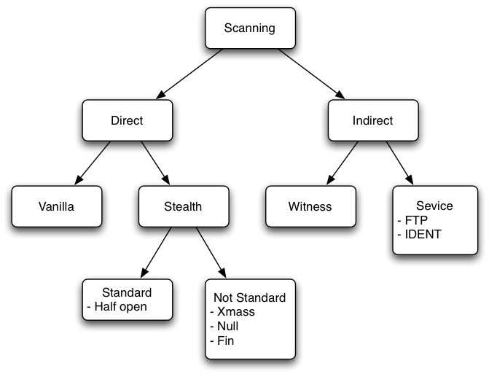
Scan types

Slide 28
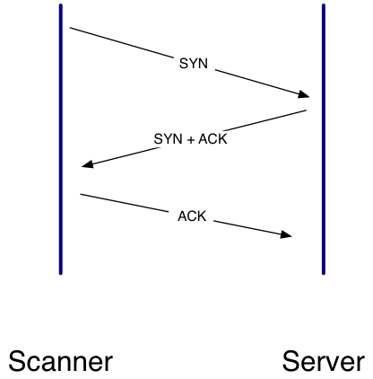
Vanilla scan 1

Slide 29
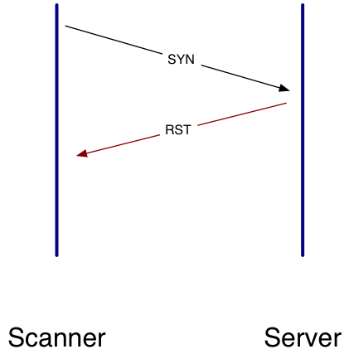
Vanilla scan 2

Slide 30
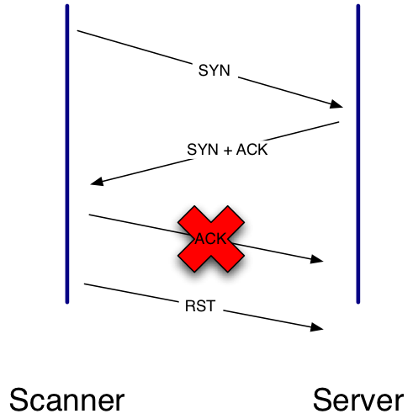
HalfOpen scan

Slide 31
Not standard scan
Violate the RFC
  Null scan : no flag
  Xmas scan : all flag
  Fin scan: Fin flag
  Maimon scan
  ACK scan / Windows scan
Notes:
Maimon scan : some BSD drop RST when port open
Ack scan used to determine which port are filtered

Slide 32


FTP
Active
Passive

Slide 33
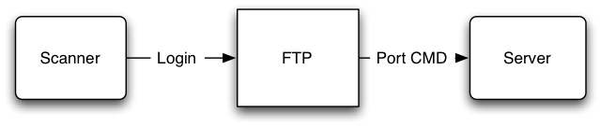
Bounce Scan

Slide 34
Idle Scan
Stealthiest scan
The victim never see the scanner ip
HomeWork !

Slide 35
Additional Manipulation
If you can’t be stealth, be noisy : decoys
Try to confuse NIDS :
  Fragmentation
  Horizontal scan

Slide 36

Nmap vs Snort
Type | Vanilla | Half | Fin | Null | UDP
 | -P0 -sT | -P0 -sF | -P0 -Sx | -P0 -sN | -P0 -sU
Default
Frag (-f)
Slow (-T2)
Very slow (-T1)
Extremely slow (-T0)

Slide 37
Service identification
Grab banner
Defense : slow down null probe
Nmap have anti-defense....
Remove / customize the banner

Slide 38
Example
Interesting ports on whispermoon (213.215.31.18):
Not shown: 989 closed ports
PORT STATE SERVICE VERSION
21/tcp open ftp (Generally vsftp or WU-FTPD)
22/tcp open ssh OpenSSH 4.7p1 Debian 8ubuntu1.2 (protocol 2.0)
25/tcp open smtp Postfix smtpd
80/tcp open http Apache httpd 2.2.8 ((Ubuntu) PHP/5.2.4-2ubuntu5.5 with Suhosin-Patch mod_ssl/2.2.8 OpenSSL/0.9.8g)
135/tcp filtered msrpc
139/tcp filtered netbios-ssn
443/tcp open ssl/http Apache httpd 2.2.8 ((Ubuntu) PHP/5.2.4-2ubuntu5.5 with Suhosin-Patch mod_ssl/2.2.8 OpenSSL/0.9.8g)
445/tcp filtered microsoft-ds
993/tcp open ssl/imap Dovecot imapd (SASL enabled)
995/tcp open ssl/pop3

Slide 39
DNS version probing
dig @Argus.stanford.edu txt chaos version.bind
version.bind. 0 CH TXT "9.4.2-P2"

Slide 40
Fingerprinting

Slide 41
Outline
Network scouting
Os fingerprinting
Vulnerability scanner
Network trace analysis

Slide 42
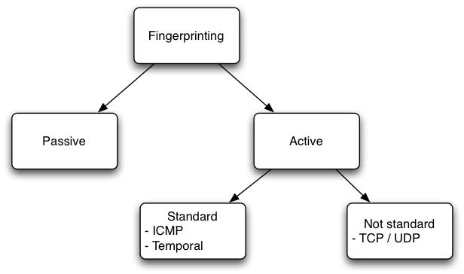
Type of fingerprinting

Slide 43
Key idea
The RFC is not well specified
Every programmer believe they now better
Network stack exhibit subtle difference

Slide 44
Passive fingerprinting
Look at packet that flow through the network
Four type of passive fingerprinting
  machines that connect to you (SYN)
  machines you connect to (SYN+ACK)
  machine you cannot connect to (RST)
  machines whose communications you can observe.

Slide 45
P0F Discriminators
Format : wwww:ttt:mmm:D:W:S:N:I:OS Description
  wwww - window size
  ttt - time to live
  mmm - maximum segment size
  D - don't fragment flag (0=unset, 1=set)
  W - window scaling (-1=not present, other=value)
  S - sackOK flag (0=unset, 1=set)
  N - nop flag (0=unset, 1=set)
  I - packet size (-1 = irrevelant)

Slide 46
P0F output
<Wed Feb 27 18:26:58 2008> 213.215.x.x:45291 - Linux 2.6 (newer, 2) (up: 1421 hrs) -> 208.83.x.x:2703 (distance 0, link: ethernet/modem)
<Wed Feb 27 18:27:02 2008> 212.24.x.x:62994 - FreeBSD 5.3-5.4 (up: 4556 hrs) -> 213.215.x.x:80 (distance 9, link: ethernet/modem)
<Wed Feb 27 18:27:16 2008> 90.2.x.x:1322 - Windows 2000 SP4, XP SP1+ -> 213.215.x.x:80 (distance 9, link: pppoe (DSL))

Slide 47
Computing Distance
Use fingerprinting
Use an heuristic based on the closest ^2
  62 -> 64 - 62 = 2
  118 -> 128 - 118 = 10

Slide 48
Link Type
Analyze the MTU (Maximum transmission unit)
Some medium have a very distinct type
  1462, "sometimes DSL (5)”
  1656, "Ericsson HIS"
M. Zalewski

Slide 49

Firewall detection
Look at the don’t fragment bit (DF)

Slide 50
Nmap Fingerprinting (v2)
Mix all previous techniques
7 TCP probes, 1 ICMP, 1 UDP
  TCP probes are sent exactly 110 milliseconds apart
  Required to analyze
    initial sequence numbers
    IP IDs
    TCP timestamps

Slide 51
Active fingerprinting
ECN notification
window scale (10), NOP, MSS (1460), timestamp (TSval: 0xFFFFFFFF; TSecr: 0), SACK permitted. The window field is 1.
MSS (1400), window scale (0), SACK permitted, timestamp (TSval: 0xFFFFFFFF; TSecr: 0), EOL. The window field is 63.
Timestamp (TSval: 0xFFFFFFFF; TSecr: 0), NOP, NOP, window scale (5), NOP, MSS (640). The window field is 4.
SACK permitted, Timestamp (TSval: 0xFFFFFFFF; TSecr: 0), window scale (10), EOL. The window field is 4.
MSS (536), SACK permitted, Timestamp (TSval: 0xFFFFFFFF; TSecr: 0), window scale (10), EOL. The window field is 16.
MSS (265), SACK permitted, Timestamp (TSval: 0xFFFFFFFF; TSecr: 0). The window field is 512.

Slide 52
Old Nmap (4.11)
nmap -v -O 192.168.0.1
Interesting ports on 192.168.0.1:
Not shown: 1678 closed ports
PORT STATE SERVICE
80/tcp open http
4444/tcp open krb524
MAC Address: 00:21:91:F8:48:3A (Unknown)
No exact OS matches for host (If you know what OS is running on it, see http://www.insecure.org/cgi-bin/nmap-submit.cgi).
Notes:
VM == problem alter subtle test

Slide 53
New Nmap 4.8x
nmap -O -v 192.168.0.1
PORT STATE SERVICE
80/tcp open http
4444/tcp open krb524
8099/tcp open unknown
MAC Address: 00:21:91:F8:48:3A (D-Link)
Device type: print server|router
Running: D-Link embedded
OS details: D-Link DPR-1260 print server, or DGL-4300 or DIR-655 router
Network Distance: 1 hop
TCP Sequence Prediction: Difficulty=174 (Good luck!)
IP ID Sequence Generation: Incremental
Notes:
from a real box

Slide 54
Why IDS detect it ?
ICMP : TOS IP_TOS_RELIABILITY
UDP : C repeated 300 times
TCP : non standard packets

Slide 55
OS uptime
TCP timestamp is incremented each second by a known value x
No random origin on Unices
uptime = x * value

Slide 56
Nat Detection
Inconstancy between the mss and the wss
Use auto-increment field
  IP ID (Windows)
  Timestamp (Unix / Windows server)

Slide 57
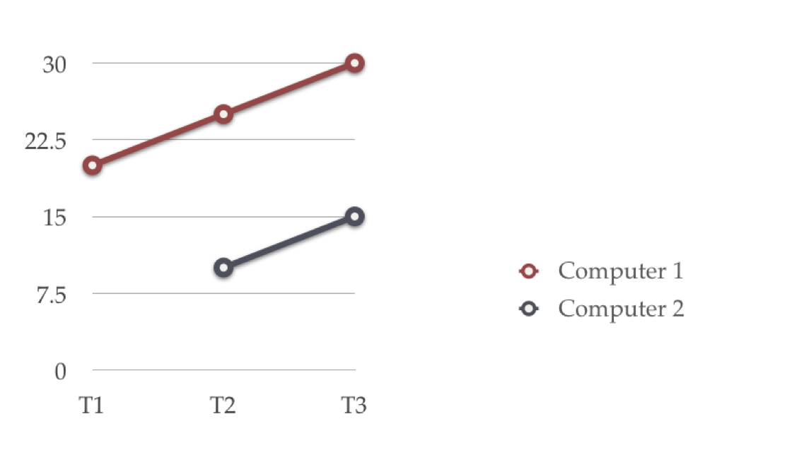
Linear regression

Slide 58
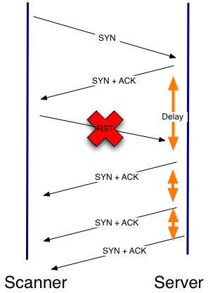
Temporal Fingerpinting
Franck Veysset, Olivier Courtay, Olivier Heen, Intranode Research Team 2002

Slide 59
Protocol Specific
Netbios (Win)
WMI (Win)
SNMP

Slide 60
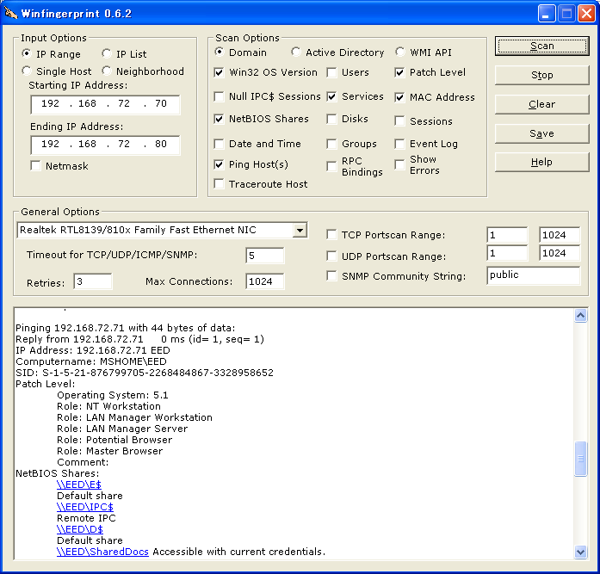
Winfingerprint

Slide 61
Vulnerability
Scanner

Slide 62
Outline
Network scouting
Os fingerprinting
Vulnerability scanner
Network trace analysis

Slide 63
What it is
A tool that given a set of
  vulnerabilities (plugins)
  hosts (scouting)
Tell which hosts is vulnerable to what

Slide 64
Type of assessment
Local
Remote
Modern vulnerability scanner
  Mix remote/ local test
  Keep a temporal record

Slide 65
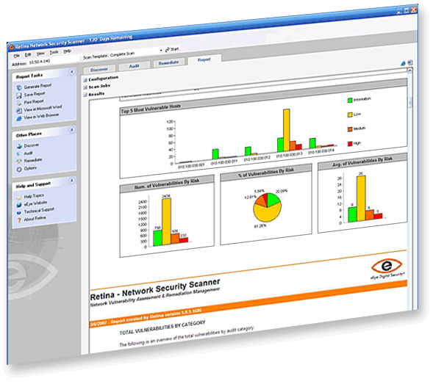
Retina

Slide 66

Nessus
Owned by tenable
Open souce -> close source

Slide 67
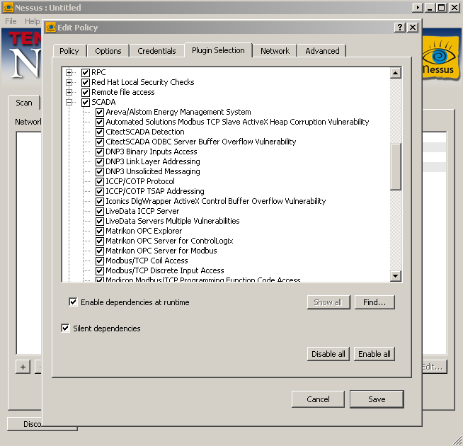

Slide 68
Difficulties
Keep an updated list of vulnerabilities
Know the OS of the host
Know the version of each service
Is able to test without breaking the service

Slide 69
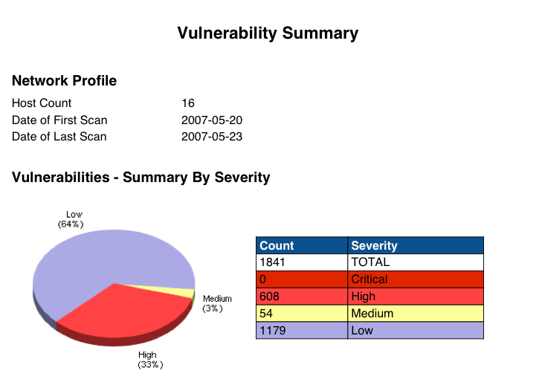
Nessus report
Tenable

Slide 70
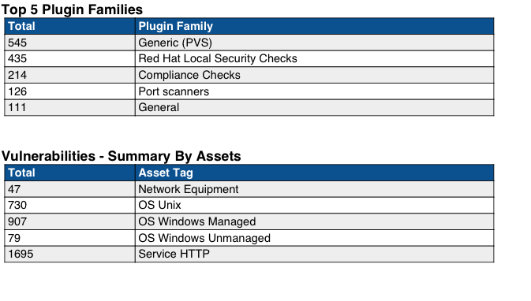
Nessus report
Tenable

Slide 71
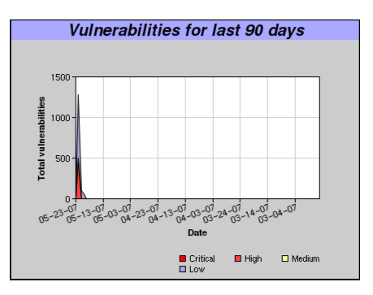
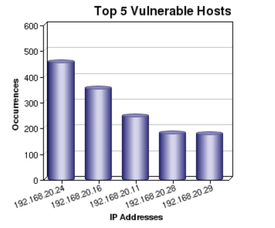
Nessus report
Tenable

Slide 72
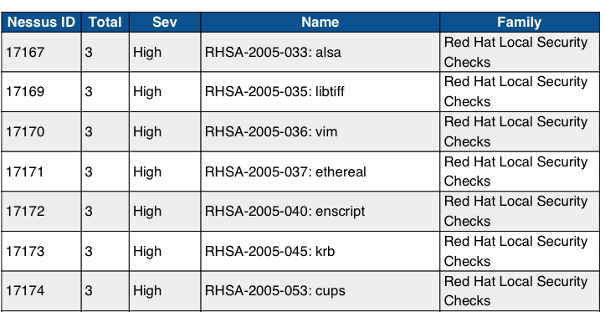
Nessus report
Tenable

Slide 73
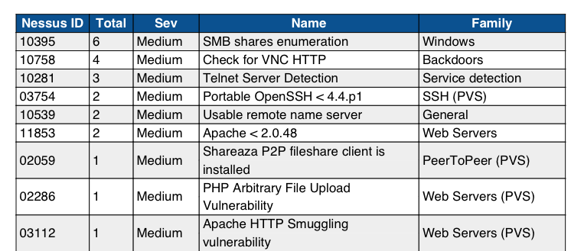
Nessus report
Tenable

Slide 74
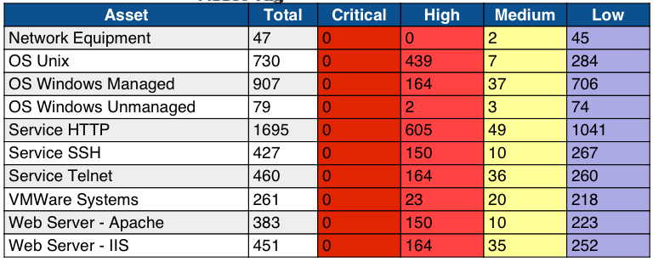
Nessus report
Tenable

Slide 75
Network Trace analysis

Slide 76
Outline
Network scouting
Os fingerprinting
Vulnerability scanner
Network trace analysis

Slide 77
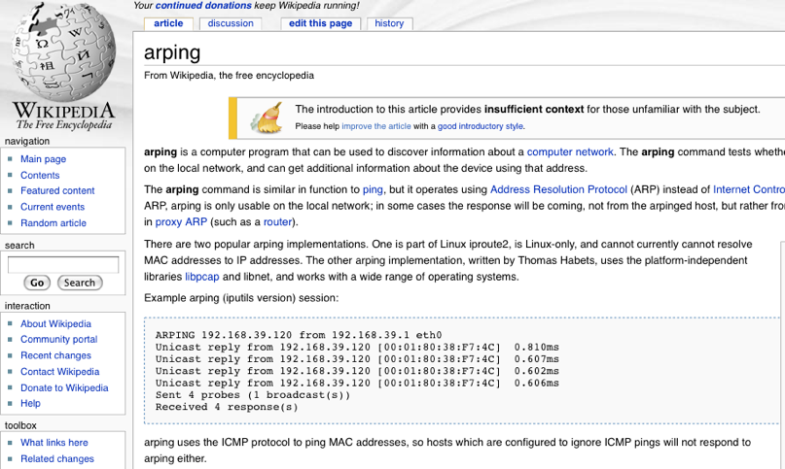
Use the network luke
13:15:46.600509 arp reply 192.168.0.1 is-at 00:21:91:f8:48:3a (oui Unknown)
13:15:47.601109 arp who-has 192.168.0.1 tell 192.168.0.194
13:15:47.604020 arp reply 192.168.0.1 is-at 00:21:91:f8:48:3a (oui Unknown)
13:15:48.605197 arp who-has 192.168.0.1 tell 192.168.0.194
13:15:48.612512 arp reply 192.168.0.1 is-at 00:21:91:f8:48:3a (oui Unknown)

Slide 78
17:31:16.301217 IP (tos 0x0, ttl 42, id 24244, offset 0, flags [none], proto: TCP (6), length: 44) 192.168.0.194.52232 > 192.168.0.1.80: S, cksum 0x6485 (correct), 3647930309:3647930309(0) win 3072 <mss 1460>
17:31:16.301667 IP (tos 0x0, ttl 57, id 37298, offset 0, flags [none], proto: TCP (6), length: 44) 192.168.0.194.52232 > 192.168.0.1.81: S, cksum 0x6884 (correct), 3647930309:3647930309(0) win 2048 <mss 1460>
17:31:16.301987 IP (tos 0x0, ttl 64, id 48783, offset 0, flags [none], proto: TCP (6), length: 44) 192.168.0.1.80 > 192.168.0.194.52232: S, cksum 0xc685 (correct), 2609643106:2609643106(0) ack 3647930310 win 4096 <mss 1460>
Notes:
half scan

Slide 79
17:31:16.417655 IP (tos 0x0, ttl 64, id 48786, offset 0, flags [none], proto: TCP (6), length: 44) 192.168.0.1.80 > 192.168.0.194.52425: S, cksum 0x8030 (correct), 2610399074:2610399074(0) ack 1654600479 win 4096 <mss 1460>
17:31:16.417679 IP (tos 0x0, ttl 64, id 0, offset 0, flags [DF], proto: TCP (6), length: 40) 192.168.0.194.52425 > 192.168.0.1.80: R, cksum 0xcaf4 (correct), 1654600479:1654600479(0) win 0
Notes:
half scan 2 confirmation

Slide 80
17:31:17.021331 IP (tos 0x0, ttl 61, id 4162, offset 0, flags [none], proto: UDP (17), length: 328) 192.168.0.194.52300 > 192.168.0.1.39695: UDP, length 300
17:31:16.993102 IP (tos 0x4, ttl 58, id 43133, offset 0, flags [none], proto: ICMP (1), length: 178) 192.168.0.194 > 192.168.0.1: ICMP echo request, id 34388, seq 296, length 158
Notes:
fingerprinting nmap

Slide 81
17:31:17.217108 IP (tos 0x0, ttl 41, id 17642, offset 0, flags [none], proto: TCP (6), length: 60) 192.168.0.194.52444 > 192.168.0.1.79: FP, cksum 0x5191 (correct), 1654600478:1654600478(0) win 65535 urg 0 <wscale 15,nop,mss 265,timestamp 4294967295 0,sackOK>
Notes:
fingerprint 2

Slide 82
01:25:08.063167 192.168.1.40.http > 192.168.1.40.http: S [bad tcp cksum a8e4!] 3868:3868(0) win 2048 (ttl 255, id 3868, len 40

Slide 83
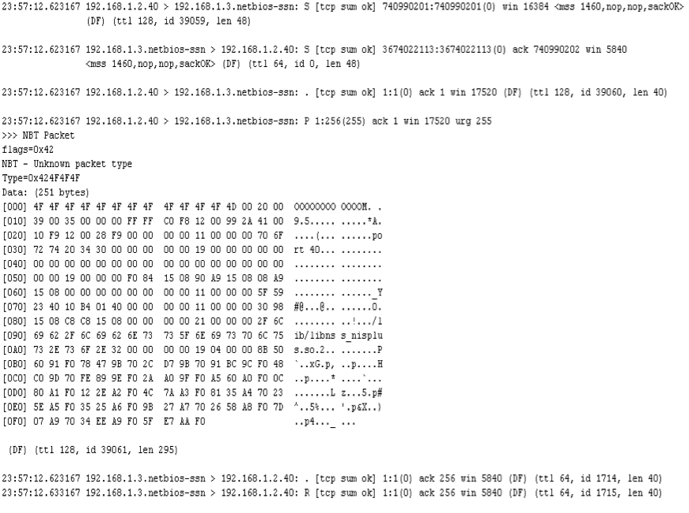
Notes:
OOB nuke / blue screen of the death win 9x

Slide 84
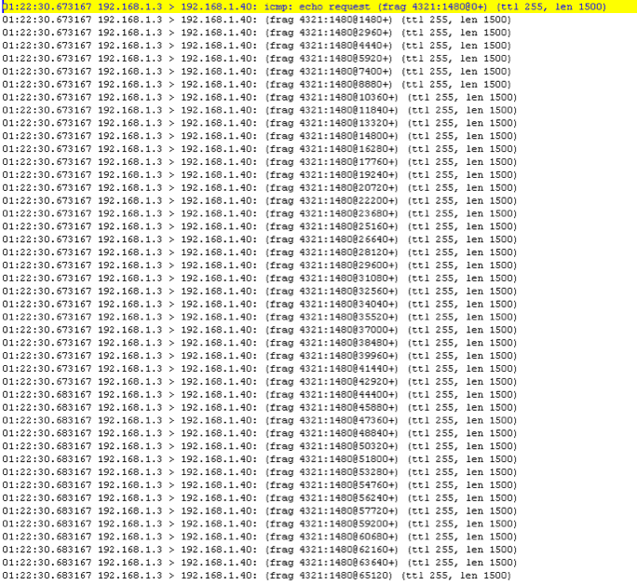
Notes:
ping of death

Slide 85
23:28:12.503167 192.168.1.2 > 192.168.0.3: icmp: 212.43.217.98 protocol 6 unreachable for 192.168.0.3.1200 > 212.43.x.x.ircd: [|tcp] (ttl 128, id 25159, len 30, bad cksum 0!) (ttl 128, id 21813, len 56)
23:28:28.693167 192.168.1.2 > 192.168.0.3: icmp: 212.43.217.98 protocol 6 unreachable for 192.168.0.3.1200 > 212.43.x.x.ircd: [|tcp] (ttl 52, id 17098, len 123, bad cksum 0!) (ttl 128, id 21989, len 56)
Notes:
click attack

Slide 86
00:48:06.523167 192.168.1.3.smtp > 192.168.1.2.smtp: [no cksum] udp 28 (frag 1109:36@0+) (ttl 255, len 56)
00:48:06.543167 192.168.1.3.smtp > 192.168.1.2.smtp: [no cksum] udp 28 (frag 1109:36@0+) (ttl 255, len 56)
00:48:06.563167 192.168.1.3.smtp > 192.168.1.2.smtp: [no cksum] udp 28 (frag 1109:36@0+) (ttl 255, len 56)
00:48:06.583167 192.168.1.3.smtp > 192.168.1.2.smtp: [no cksum] udp 28 (frag 1109:36@0+) (ttl 255, len 56)
Notes:
boink

Slide 87

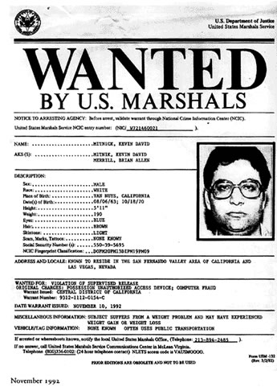
Kevin Mitnick
August 6, 1963
12: bypass the bus punchcard system
1979 Hack DEC to view VMS source code
Hacking of Motorola, NEC, Nokia, Sun Microsystems and Fujitsu Siemens systems
Arrested in 1995
Notes:
First FBI warrant for a hacker
Gaining full admin privileges to an IBM microcomputer to win a bet

Slide 88
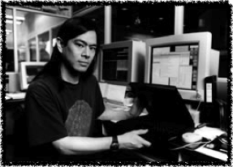
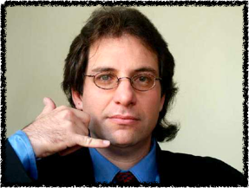
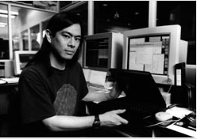

Mitnick vs Shimomura
Notes:
http://www.gulker.com/ra/hack/tsattack.html

Slide 89


Slide 90
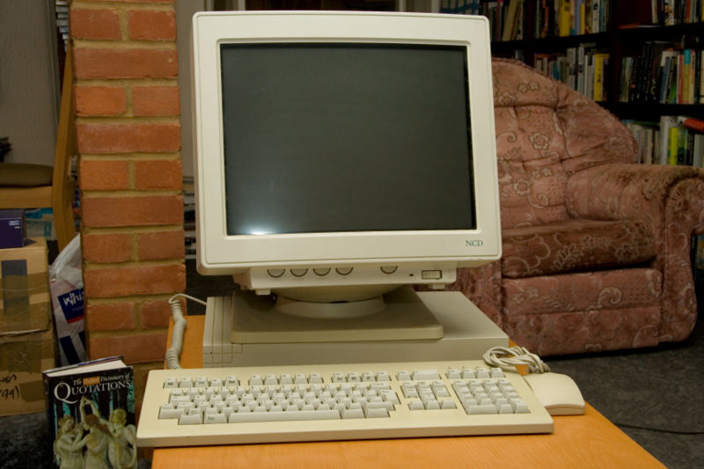
Setup
X-Terminal
Server

Slide 91
Step 1 12/25/94
14:09:32 toad.com# finger -l @target
14:10:21 toad.com# finger -l @server
14:10:50 toad.com# finger -l root@server
14:11:07 toad.com# finger -l @x-terminal
14:11:38 toad.com# showmount -e x-terminal
14:11:49 toad.com# rpcinfo -p x-terminal
14:12:05 toad.com# finger -l root@x-terminal

Slide 92
Step 2 flood
14:18:24.382841 130.92.6.97.619 > server.login: S 1382726979:1382726979(0) win 4096
14:18:24.443309 130.92.6.97.620 > server.login: S 1382726980:1382726980(0) win 4096
14:18:24.643249 130.92.6.97.621 > server.login: S 1382726981:1382726981(0) win 4096
14:18:24.906546 130.92.6.97.622 > server.login: S 1382726982:1382726982(0) win 4096
14:18:24.963768 130.92.6.97.623 > server.login: S 1382726983:1382726983(0) win 4096
14:18:25.022853 130.92.6.97.624 > server.login: S 1382726984:1382726984(0) win 4096
14:18:25.153536 130.92.6.97.625 > server.login: S 1382726985:1382726985(0) win 4096
14:18:25.400869 130.92.6.97.626 > server.login: S 1382726986:1382726986(0) win 4096
14:18:25.483127 130.92.6.97.627 > server.login: S 1382726987:1382726987(0) win 4096
14:18:25.599582 130.92.6.97.628 > server.login: S 1382726988:1382726988(0) win 4096
14:18:25.653131 130.92.6.97.629 > server.login: S 1382726989:1382726989(0) win 4096
Notes:
Flood UNIX "r-services" (rsh, rlogin). 130.92.6.97 appears to be forged and unused

Slide 93
Step 3 prediction
14:18:34.375641 x-terminal.shell > apollo.it.luc.edu.984: S 2023872000:2023872000(0) ack 1382727007 win 4096
14:18:34.452830 apollo.it.luc.edu.984 > x-terminal.shell: R 1382727007:1382727007(0) win 0
14:18:34.714996 apollo.it.luc.edu.983 > x-terminal.shell: S 1382727007:1382727007(0) win 4096
14:18:34.885071 x-terminal.shell > apollo.it.luc.edu.983: S 2024000000:2024000000(0) ack 1382727008 win 4096
14:18:34.962030 apollo.it.luc.edu.983 > x-terminal.shell: R 1382727008:1382727008(0) win 0
14:18:35.225869 apollo.it.luc.edu.982 > x-terminal.shell: S 1382727008:1382727008(0) win 4096
14:18:35.395723 x-terminal.shell > apollo.it.luc.edu.982: S 2024128000:2024128000(0) ack 1382727009 win 4096
14:18:35.472150 apollo.it.luc.edu.982 > x-terminal.shell: R 1382727009:1382727009(0) win 0
14:18:35.735077 apollo.it.luc.edu.981 > x-terminal.shell: S 1382727009:1382727009(0) win 4096
14:18:35.905684 x-terminal.shell > apollo.it.luc.edu.981: S 2024256000:2024256000(0) ack 1382727010 win 4096
14:18:35.983078 apollo.it.luc.edu.981 > x-terminal.shell: R 1382727010:1382727010(0) win 0

Slide 94
Step 4 blind spoofing
14:18:36.245045 server.login > x-terminal.shell: S 1382727010:1382727010(0) win 4096
14:18:36.755522 server.login > x-terminal.shell: . ack 2024384001 win 4096

Slide 95
Insertion
14:18:37.265404 server.login > x-terminal.shell: P 0:2(2) ack 1 win 4096
14:18:37.775872 server.login > x-terminal.shell: P 2:7(5) ack 1 win 4096
14:18:38.287404 server.login > x-terminal.shell: P 7:32(25) ack 1 win 4096
14:18:37 server# rsh x-terminal "echo + + >>/.rhosts"
Notes:
Total elapsed time since the first spoofed packet: < 16 seconds

Slide 96
Closing up
14:18:41.347003 server.login > x-terminal.shell: . ack 2 win 4096
14:18:42.255978 server.login > x-terminal.shell: . ack 3 win 4096
14:18:43.165874 server.login > x-terminal.shell: F 32:32(0) ack 3 win 4096
14:18:52.179922 server.login > x-terminal.shell: R 1382727043:1382727043(0) win 4096
14:18:52.236452 server.login > x-terminal.shell: R 1382727044:1382727044(0) win 4096

Slide 97
Cleaning up
14:18:52.298431 130.92.6.97.600 > server.login: R 1382726960:1382726960(0) win 4096
14:18:52.363877 130.92.6.97.601 > server.login: R 1382726961:1382726961(0) win 4096
14:18:52.416916 130.92.6.97.602 > server.login: R 1382726962:1382726962(0) win 4096
14:18:52.476873 130.92.6.97.603 > server.login: R 1382726963:1382726963(0) win 4096
14:18:52.536573 130.92.6.97.604 > server.login: R 1382726964:1382726964(0) win 4096
14:18:52.600899 130.92.6.97.605 > server.login: R 1382726965:1382726965(0) win 4096
14:18:52.660231 130.92.6.97.606 > server.login: R 1382726966:1382726966(0) win 4096
14:18:52.717495 130.92.6.97.607 > server.login: R 1382726967:1382726967(0) win 4096
14:18:52.776502 130.92.6.97.608 > server.login: R 1382726968:1382726968(0) win 4096

Slide 98
Terminal hijhacking
x-terminal% modstat
Id Type Loadaddr Size B-major C-major Sysnum Mod Name
1 Pdrv ff050000 1000 59. tap/tap-2.01 alpha
x-terminal% ls -l /dev/tap
crwxrwxrwx 1 root 37, 59 Dec 25 14:40 /dev/tap
Notes:
Kernel module used to control already laucnhed STREAM

